Slide 1
Fit & Fun
AI-Powered Workout Companion

Slide 2
Table of Contents
Key Features
Screenshots
Forgot Password Implementation
Persistent Drawer Navigation
Profile and Update Functionality
Chatbot Integration
Success and Error Message Handling
Conclusion

Slide 3
Introduction
The Fit & Fun React application is an innovative project aimed at providing users with an AI-powered workout companion.
The application offers a seamless blend of user-friendly interfaces, efficient backend processes, and essential security measures to ensure a comprehensive fitness experience.

Slide 4
Key Features
Persistent Drawer Navigation
User Profile and Update Functionality
Chatbot for interactive assistance
Secure authentication with JWT
Axios for access data and
Password management features

Slide 5
Enhanced Navigation and User Interface
Initial State: Basic navigation was implemented, primarily focused on essential links and functionality.
Now: Introduced a persistent drawer navigation using Material-UI, significantly improving user accessibility and overall app navigation experience.

Slide 6
User Profile Management
Initial State: Limited user interaction and profile management capabilities.
Now: Developed comprehensive user profile management features, including viewing and updating profile information, which enhanced user personalization and engagement.

Slide 7
Interactive Chatbot Integration
Initial State: No interactive assistance available for users.
Now: Integrated a chatbot using the `react-simple-chatbot` library to provide users with real-time assistance and support, making the app more interactive and user-friendly.

Slide 8
Advanced Authentication and Security
Initial State: Basic authentication mechanisms were in place.
Now: Implemented JWT authentication for secure user login and session management. Leveraged Axios for efficient HTTP requests to handle login, registration, and token management. This ensured data integrity, enhanced security, and improved user experience.

Slide 9
Endpoints and Routing: Their Role and Benefits
Endpoints are specific paths defined in the backend that correspond to various functionalities, such as user registration, login, data retrieval, and updates.
Routing is the mechanism that directs incoming HTTP requests to the appropriate endpoint based on the request URL and method (GET, POST, PUT, DELETE).

Slide 10
Role of Endpoints and Routing
Request Handling: Handles all kind of requests with data or without data from client to the server seamlessly.
Separation of Concerns: Routing helps in organizing the codebase by separating different functionalities into distinct modules. For example, user-related endpoints are grouped under user routes, and product-related endpoints under product routes.
API Structure: Well-defined endpoints provide a structured and predictable API for frontend developers to interact with the backend services.
Security: Routing allows for the implementation of middleware functions that can perform tasks such as authentication, authorization, and validation before processing the request at the endpoint. This ensures that only authenticated and authorized users can access certain resources.
Scalability: By organizing endpoints and routes efficiently, the application can scale more effectively.

Slide 11
API Endpoints
Endpoints Created:
/api/register: User registration
/api/login: User login
/api/forgot-password: Password reset
/api/update-profile: Update user profile
/api/delete-user: Delete user data and profile.
/home: Home page
/ : Landing Page and many more.

Slide 12
Advantages of Endpoints & Routing
Improved Maintainability
Enhanced Security
Efficiency in the Development
Error handling
Performance optimisation
Faster and safe data transfer.

Slide 13
JWT Implementation
Outcomes:
Generate unique JWT with time bound on user login.
This Token is stored as a cookie in the client’s browser.
Middleware to verify JWT on protected routes.
Secure endpoints to ensure only authenticated users can access them.

Slide 14
Screenshots

Slide 15
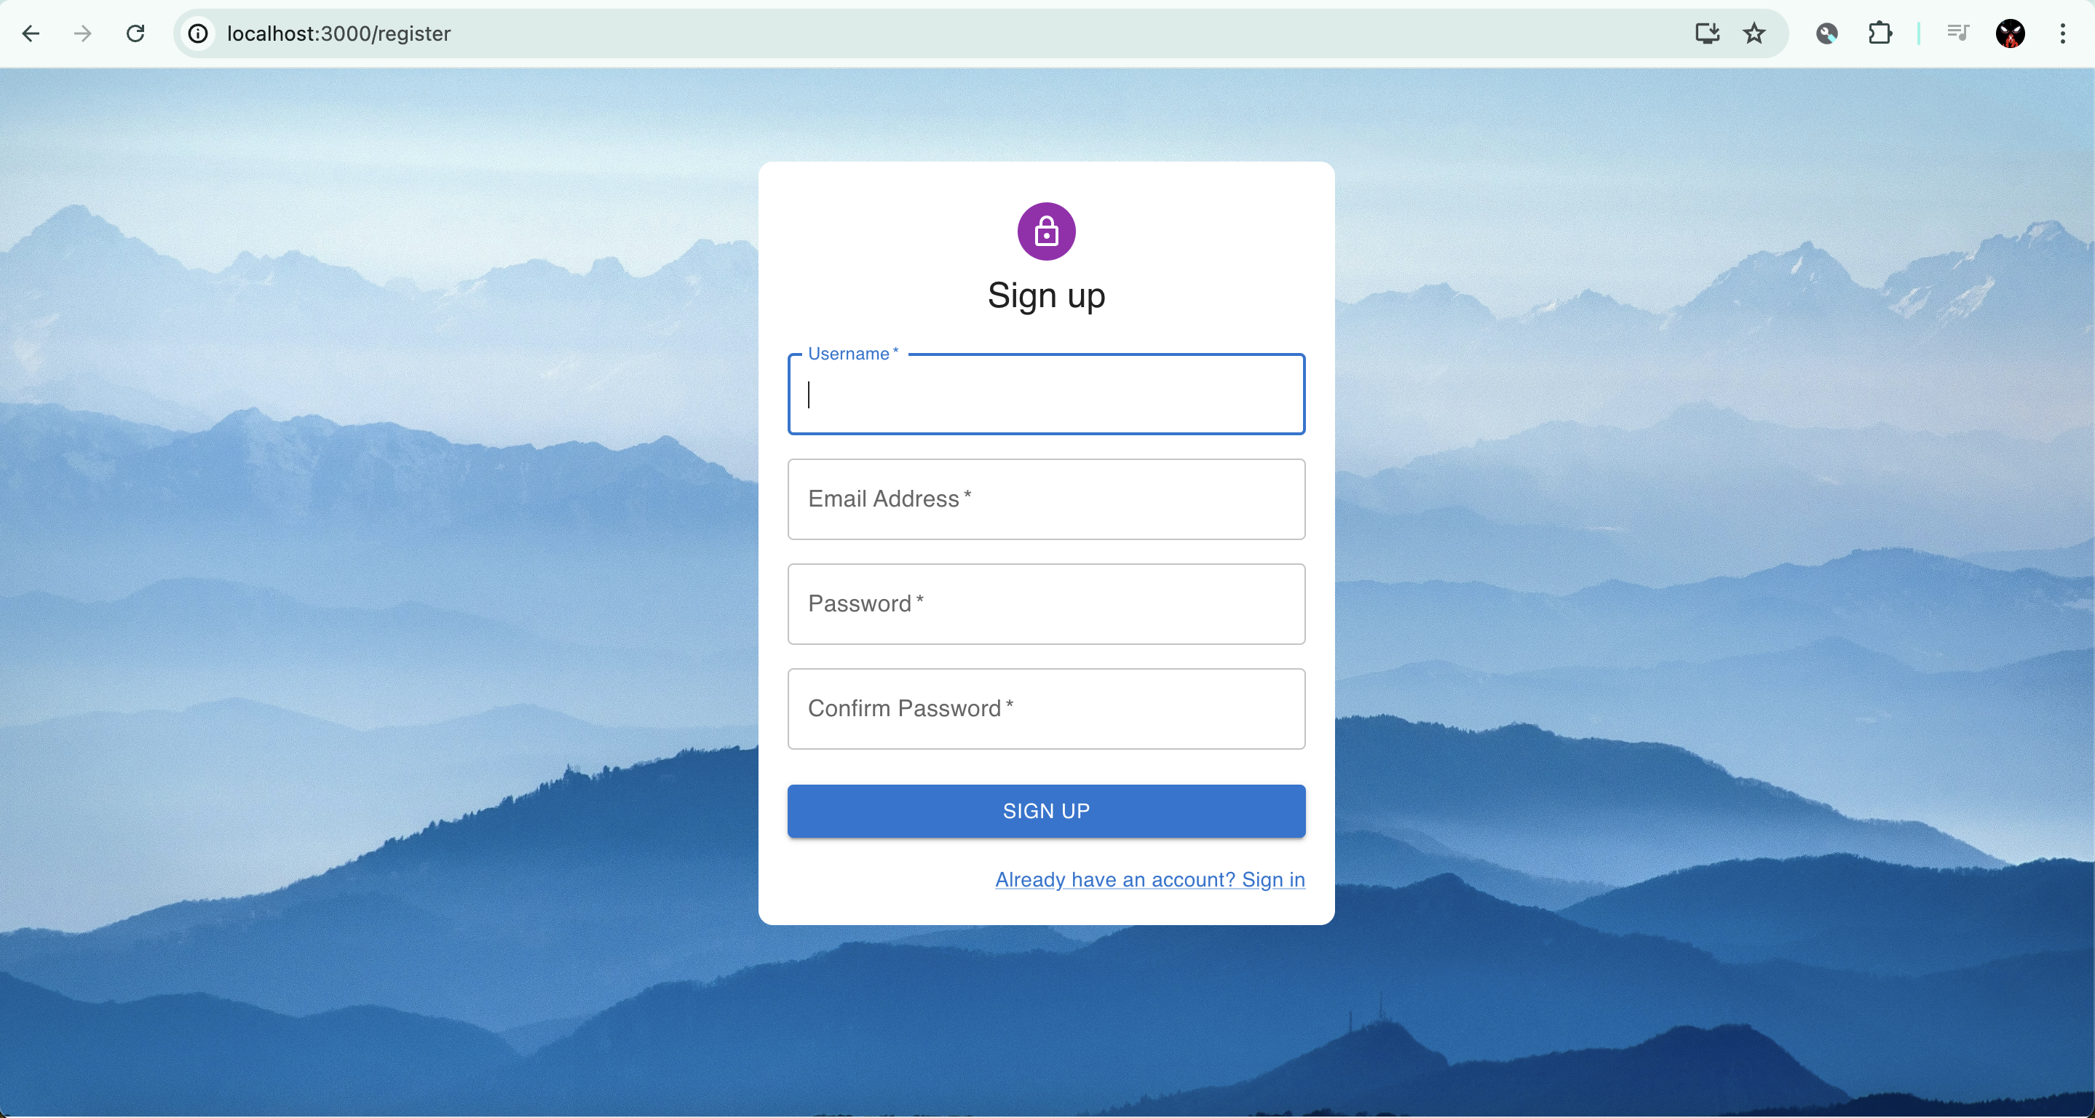

Slide 16


Slide 17
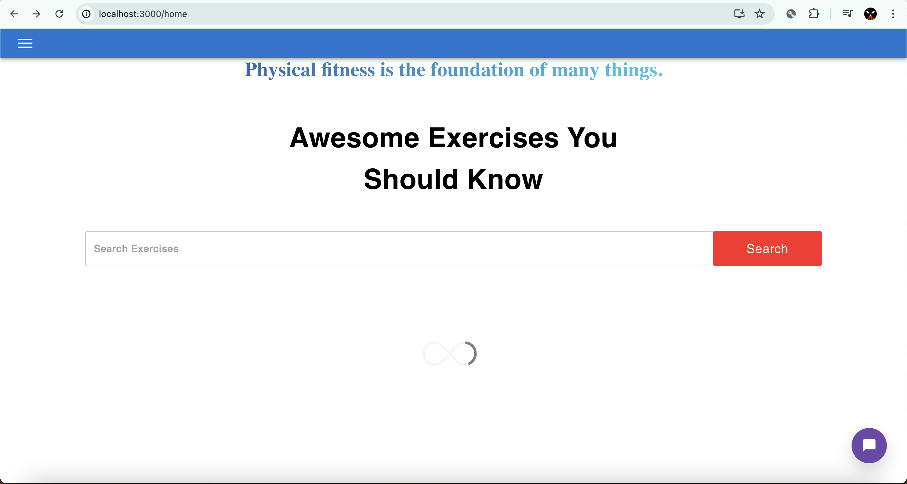
Home Page

Slide 18
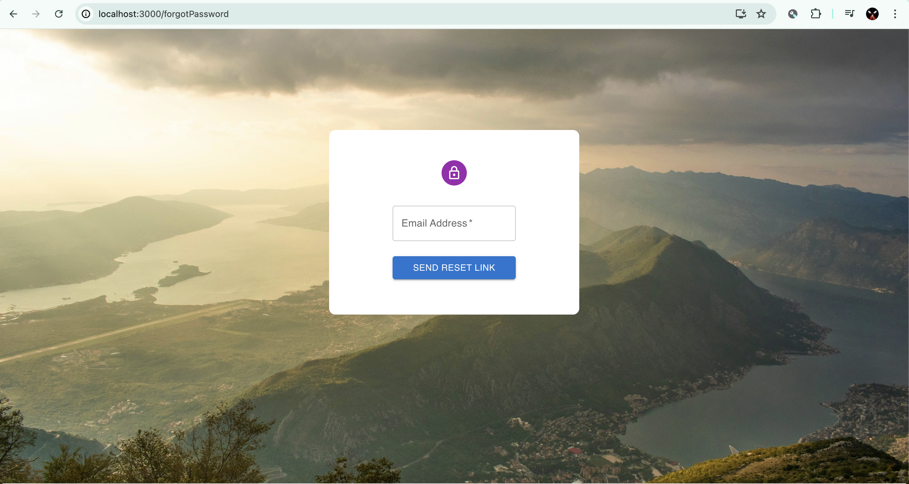
Forgot Password

Slide 19
Forgot Password Implementation
Forgot Password Feature
Steps:
Frontend form to collect user's email.
Backend endpoint to handle password reset requests.

Slide 20
Email Integration
Steps:
Generate a unique token for password reset.
Send password reset email to the user.
Endpoint to handle password reset using the token.

Slide 21
Persistent Drawer Navigation
Implementing Drawer
Tools Used: Material UI
Steps:
Set up the Drawer component using Material UI.
Add navigation links to different pages like Home, Profile, etc.

Slide 22
Drawer Features
Features:
Persistent state: Remains open or closed based on user interaction.
Responsive design: Adjusts based on screen size.
Customizable: Easily add or remove navigation links.

Slide 23
Chatbot Integration
Chatbot Setup
Tools Used: react-simple-chatbot
Steps:
Install and configure react-simple-chatbot.
Define conversation steps and triggers.

Slide 24
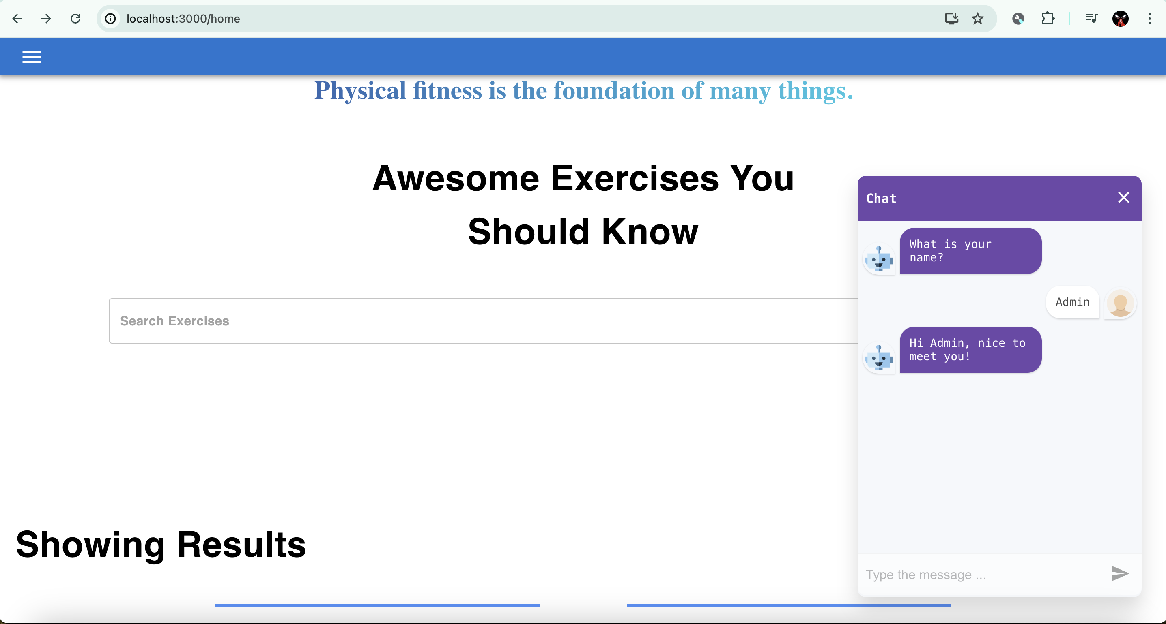
ChatBot Integration

Slide 25
Chatbot Features
Features:
Interactive questions and answers.
Personalized greetings and responses.
Enhances user engagement and provides instant assistance.

Slide 26
Success and Error Message Handling
Success Messages
Styled Message:
Green text for success messages.
Display message upon successful operations like successful registration, profile update, password reset request and many more.

Slide 27
Error Messages
Styled Message:
Red text for error messages.
Display message when operations fail, such as invalid login credentials, failed API requests.

Slide 28
Conclusion
Summary of Achievements
Features Implemented:
Secure user authentication and management.
Interactive and responsive UI.
Real-time chatbot for user assistance.
Robust backend with MongoDB integration.

Slide 29
Future Work
Planned Enhancements
Advanced workout tracking features.
Integration with fitness devices.
More personalized AI recommendations.

Slide 30

Thank you

